Slide 1

CMSC 137
Data Communications and Networking
Lecture Module
21 - Routing

Slide 2
Module 21: Routing
Rozano S. Maniaol
Lecturer

Slide 3
Introduction
The goal of the network layer is to deliver a datagram from its source to its destination or destinations
Terms:
Routing – process of selecting a path for traffic in a network or across multiple networks
  Unicast Routing – if a datagram is destined for only one destination
  Multicast Routing – if a datagram is destined for several destinations
Forwarding – the way a packet is delivered to the next station

Slide 4
Unicast Routing

Slide 5
Unicast Routing
A packet is routed, hop by hop, from its source to its destination by the help of forwarding tables
Routing a packet from its source to destination means routing the packet from a source router (the default router of the source host) to a destination router (the router connected to the destination network)
To find the best route, an internet can be modeled as a graph
  Actually modeled as a weighted graph

Slide 6
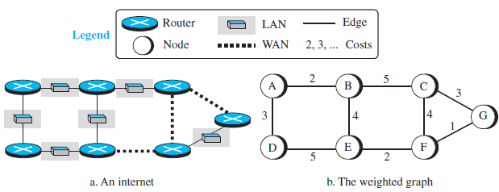
Least Cost Routing
The source router chooses a route to the destination router in such a way that the total cost for the route is the least cost among all possible routes

Slide 7
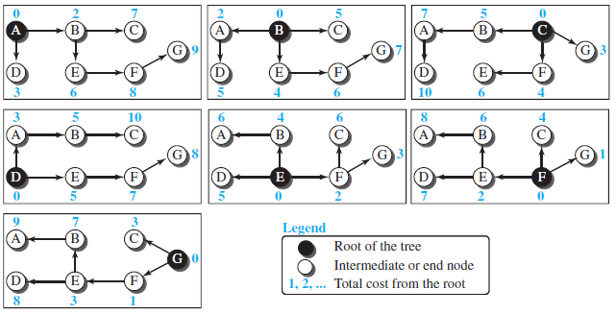
Least Cost Tree
Tree with the source router as the root that spans the whole graph and in which the path between the root and any other node is the shortest

Slide 8
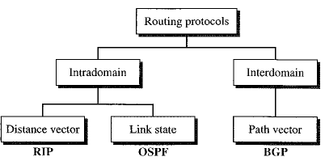
Routing Algorithm

Slide 9
Distance-Vector Routing
Each node creates its own least-cost tree with the rudimentary information it has about its immediate neighbors
The incomplete trees are exchanged between immediate neighbors to make the trees more and more complete and to represent the whole internet
Bellman-Ford equation – used to find the least cost between a source node x, and a destination node y, through some intermediary nodes (a, b, c,…) when the costs between the source and the intermediary nodes and the least costs between the intermediary nodes and destination are given
D_{ij} – shortest distance
c_{ij} – cost between nodes i and j

Slide 10
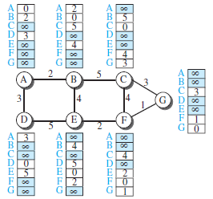
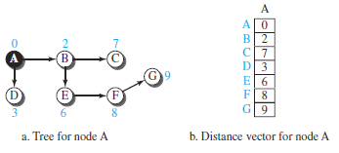
Distance Vector
One-dimensional array to represent the tree
The name defines the root, the indexes defines the destinations and the values of each cell defines the least cost from the root to the destination
A distance vector does not give the path to the destination, only the least costs to the destination

Slide 11
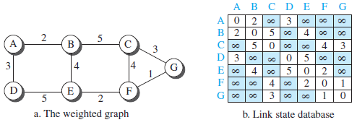
Link-State Routing
This method uses the term link-state to define the characteristic of a link (edge) that represents a network in the internet
To create a least-cost tree, each node needs a complete map of the network
The collection of states for all links is called the link-state database (LSDB)

Slide 12
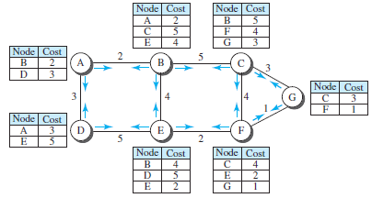
Link-State Routing
Flooding – each node can send some greeting messages to all its immediate neighbors to collect two pieces of information for each neighboring node: the identity of the node and the cost of the link (LS packet/LSP)

Slide 13
Link-State Routing
Formation of Least-Cost Trees
  Using the shared LSDB, each node runs the Dijkstra Algorithm
    The node chooses itself as the root of the tree, creating a tree with a single node, and sets the total cost of each node on the information in the LSDB
    The node selects one node, among all nodes not in the tree, which is closest to the root, and adds this to the tree. After this node is added to the tree, the cost of all other nodes not in the tree needs to be updated because the paths may have been changed
    The node repeats step 2 until all nodes are added to the tree

Slide 14
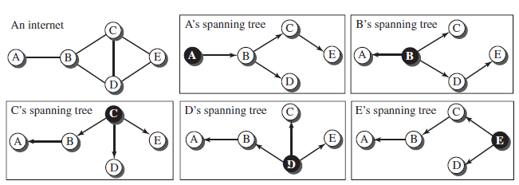
Path-Vector Routing
The best path is determined by the source using the policy it imposes on the route, i.e. the source controls the path
The path is also determined by the best spanning tree. It is not the least-cost tree; it is the tree determined by the source when it imposes its own policy

Slide 15
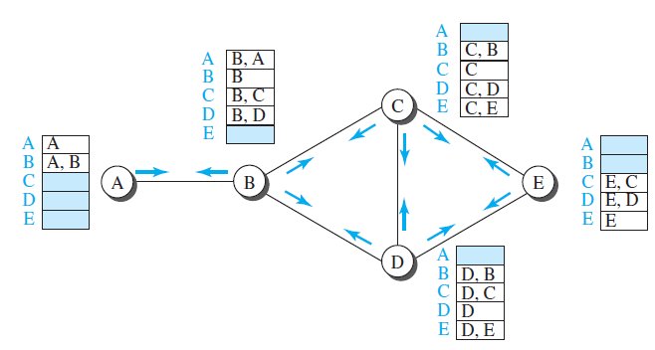
Path-Vector Routing
Spanning trees are made by each node gradually and asynchronously
When a node is booted, it creates a path vector based on the information it can obtain about its immediate neighbor
Each node sends it to all it immediate neighbors.
Each node, when it receives a path vector, updates it path vector by applying its own policy instead of look for the least cost
The policy is defined by selecting the best of multiple paths

Slide 16


Example
R2
10 Gbps
10 Gbps
R1
R3
100 Mbps
1 Gbps
1 Gbps
R4
R5
10 Gbps

Slide 17
Distance-Vector Routing
R2
10 Gbps
10 Gbps
R1
R3
100 Mbps
1 Gbps
1 Gbps
R4
R5
10 Gbps

Slide 18
Link-State Routing
R2
10 Gbps
10 Gbps
R1
R3
100 Mbps
1 Gbps
1 Gbps
R4
R5
10 Gbps

Slide 19
Path-Vector Routing
R2
10 Gbps
10 Gbps
R1
R3
100 Mbps
X
1 Gbps
1 Gbps
R4
R5
10 Gbps
Policy
R1 and R4 not allowed

Slide 20
IP Forwarding

Slide 21
IP Forwarding
Forwarding of packets in the Internet means delivering the packet to the next hop (can be the final destination host or a router)
When IP is used as connection-less
  Forwarding is based on the destination address of the IP datagram
When IP is used as connection-oriented (virtual circuit)
  Forwarding is based on the label attached to the IP datagram

Slide 22
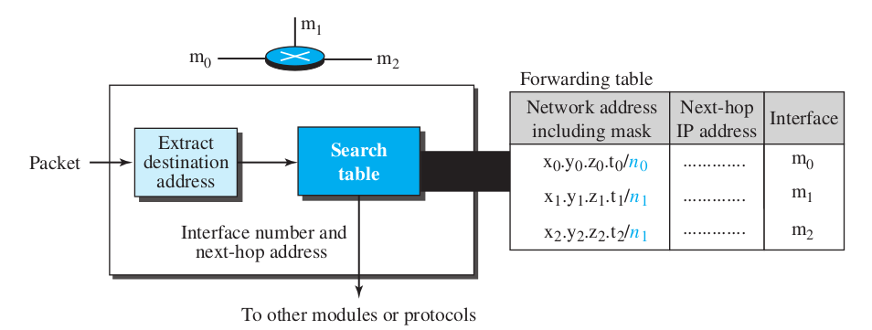
Forwarding based on Destination Address
The traditional approach which requires a host or router to have a forwarding/routing table
In classless addressing, the routing table must have the following information: network mask, network address, interface number, IP address of next router
Forwarding module searches the forwarding table row by row

Slide 23
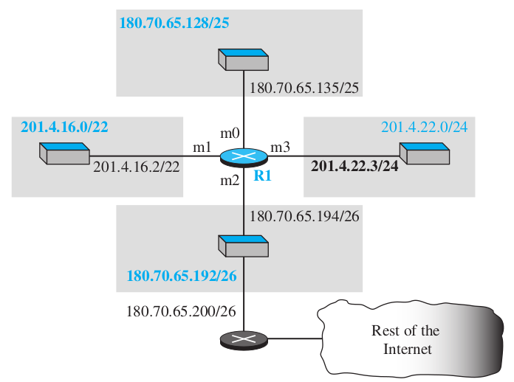
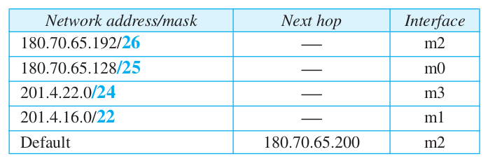
Forwarding based on Destination Address
Example: Make the forwarding table for router R1 given the following configuration

Slide 24
Forwarding based on Destination Address
Example: Show the forwarding process if a packet arrives at R1 with the destination address 180.70.65.140
Solution: Process row by row to get the network address from the destination address
  First Row: 180.70.65.140 & 255.255.255.192 = 180.70.65.128 (Not a match)
  Second Row: 180.70.65.140 & 255.255.255.128 = 180.70.65.128 (A match!), thus forward to interface m0

Slide 25
Forwarding Table Search Algorithm
Longest Prefix Match: forwarding table is sorted from the longest mask to the shortest mask
  Example: If there are three masks: /27, /26, /24 then /27 must be the first entry
It is possible that the forwarding table may grow very large thus the algorithm may become very slow
Solution is to use a different data structure, such as a trie

Slide 26
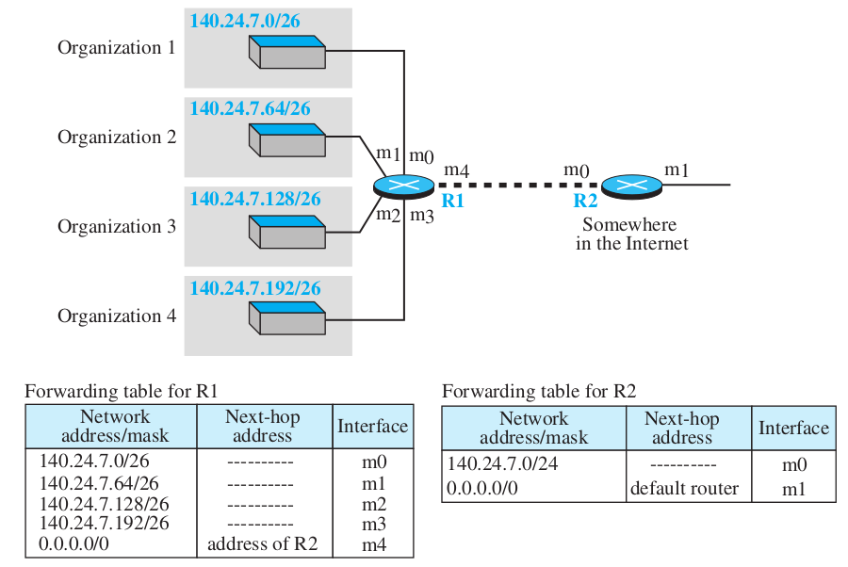
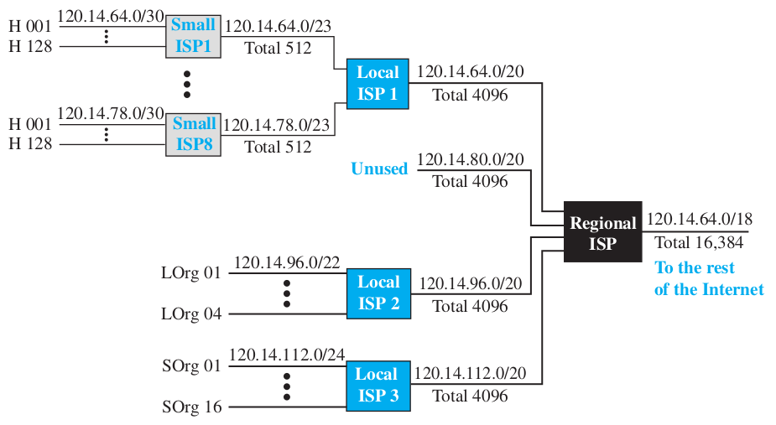
Other Approaches (Destination Address based)
Address Aggregation
  Blocks of addresses are aggregated into one larger block
Hierarchical Routing and Geographical Routing
  Takes advantage of the hierarchy in the Internet

Slide 27
References
Forouzan, B.A. 2013. Data Communications and Networking, 5th Ed. McGraw-Hill, New York.

